Slide 1
Pre-course maps

Slide 2
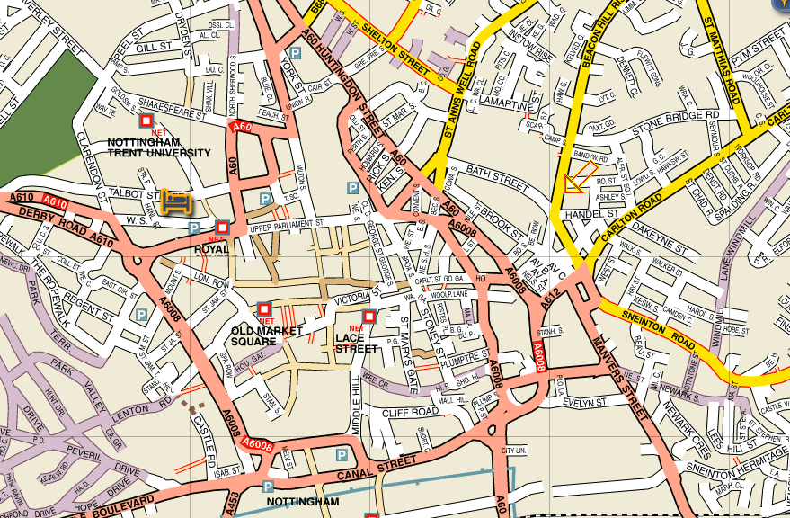
Evening meetings
A.W.Lymn (Funeral Service) 0115 950 5875
Robin Hood House, Robin Hood Street, Nottingham, NG3 1GF
If you are in trouble
David Crooks: 07855 897 745
Peter Munro: 07814 305 291

Slide 3
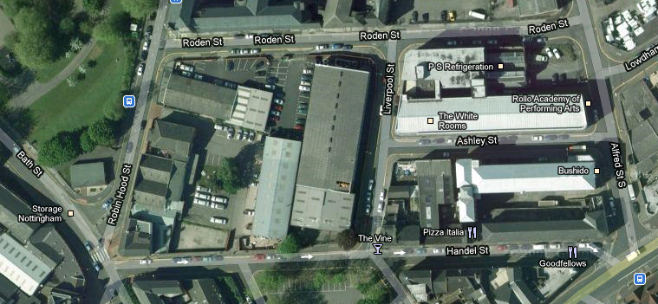
Evening meetings
A.W.Lymn (Funeral Service)
Robin Hood House, Robin Hood Street, Nottingham, NG3 1GF 0115 950 5875
Entrance
Exit – turn left!
Meet in Training Room

Slide 4
IAM Nottingham Trent Group
Welcome

Slide 5
How to get out!
Entrance
Exit – Press button; turn left!
Meet in Training Room

Slide 6
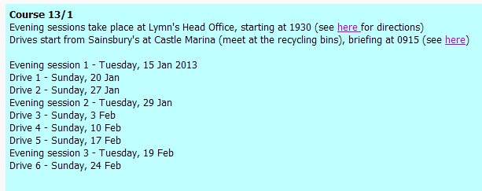
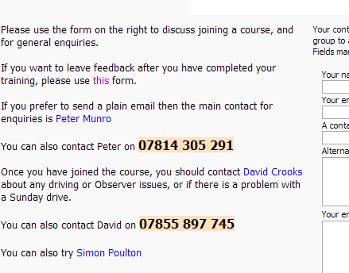
Everything is on the web!
trentiam.org.uk
Meeting/Drive dates
Things to know
Maps

Slide 7
Notts Trent Group vs. National Body
Membership/Subscriptions (two!)
Benefits of membership
Who are you?
What do you want/expect out of this course?

Slide 8
How it works
Evening meetings
Six Sunday drives (approx) in your car
Observers, Trainee Observers
Observers are not Instructors!
Will do a disclaimer
Our way (multiple Observers) vs. One Observer
Where we meet on Sundays

Slide 9
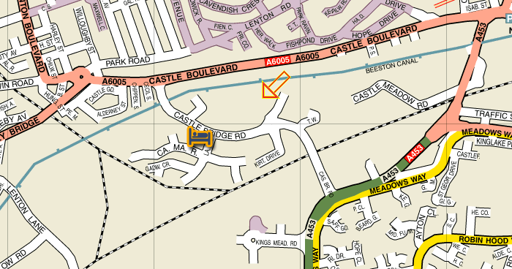
Recycling area
Sainsbury's Superstore
Castle Bridge Road Nottingham
NG7 1GX
Start time 0930 on Sunday – with fuel!
Be there by 0915 for briefing
Expect it to take 1.5 – 2 hours
Tell your Observer if there is a problem
Contact details are in your booklet
If you are in trouble, contact David Crooks:
0115 928 0949 / 07855 897 745
PizzaHut
JS
Holiday Inn
http://www.sainsburys.co.uk/sol/storelocator/storelocator_detail_view.jsp?storeId=813&bmForm=store_details

Slide 10
Who we are and who to call
Usually your Observer
David Crooks (Chief Observer)
0115 928 0949 / 07855 897 745
Observer issues, Driving problems
Peter Munro (Chairman)
07814 305 291

Slide 11
How it works
What if you cannot make an assigned drive?
Basically you miss the drive
Booklets and tick-sheet – always bring it
Implement it when driving on your own!
We cannot teach you everything in six drives
Practice is essential
What we and the examiners look at
13 Things (see booklet)
But!
Books
Manual, Highway Code, Roadcraft, Traffic signs

Slide 12
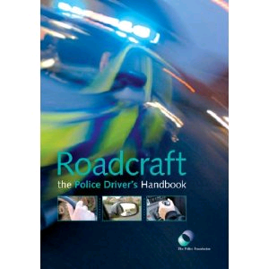
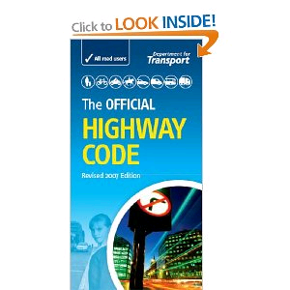
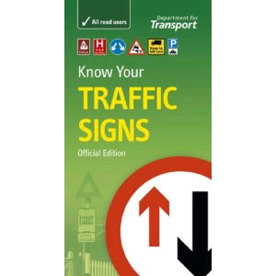
Books
£10.23
£2.05
£3.74
Prices on Amazon.co.uk as at 9 Jan 2013

Slide 13
Risk assessment
Car condition/legality
Phones
On that sort of subject
Automatics
Cruise Control and other aids
Sat Nav
After the test
Be an Observer
Be involved with the Group
IAM Masters

Slide 14
Finally
It is not meant to be hard
Nearly everyone from our group passes the test
It is not meant to be easy
You will have to work
You will have to practice on your own
But not everyone gets that far
Do not like their driving being assessed
Do not like pernickety detail
Do not like driving
Remember that it will be a different Observer next week who will do things differently

Slide 15
Introduction to Advanced Driving

Slide 16
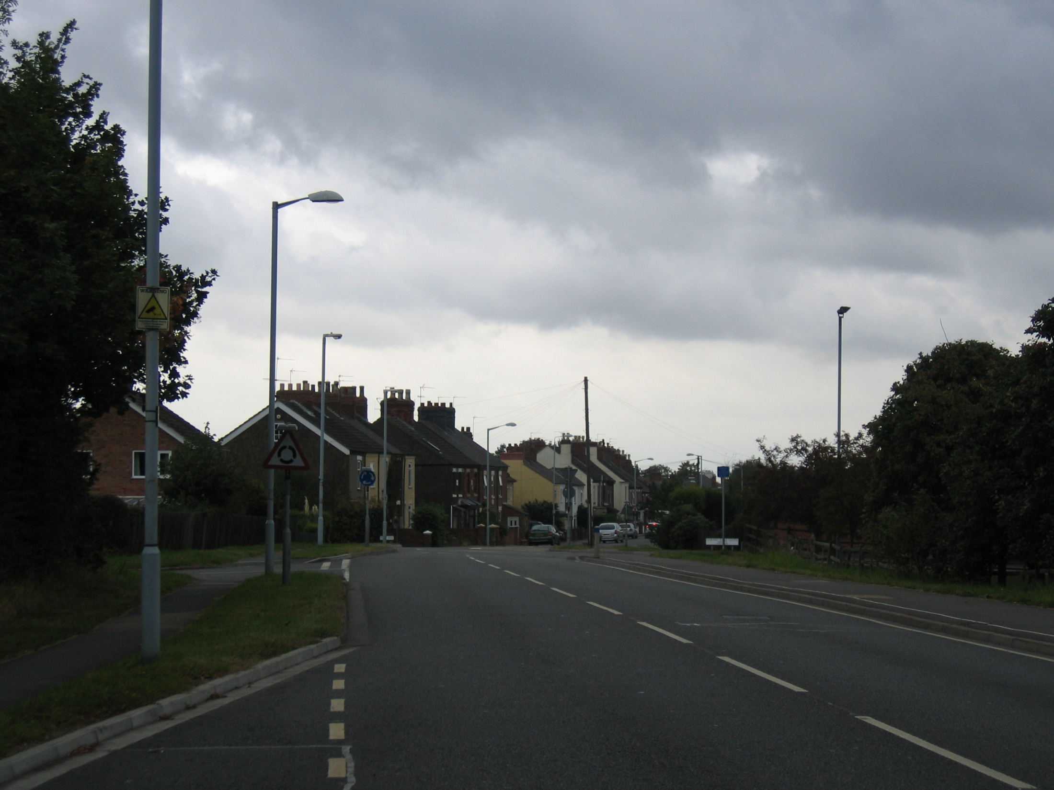
What is Advanced Driving?
Why is that when I drive this it will (probably) be Advanced, but when my 17 year old nephew drives it it probably isn’t?
What criteria does the examiner use to decide?

Slide 17
Advanced Driving
What is it?
In 1934 the accident rate for London's Police drivers was 1 in every 8000 miles...
The 'Advanced' course …‘Applying basic driving skills to the Police need for maintaining rapid progress in all traffic conditions with the driver always in complete control.‘
After just four years the accident rate had reduced to 1 in 22000 miles.
1954 'The Hendon Technique of Driving' published
... renamed 'Roadcraft‘
Without breaking the law
Advanced Driving = “The System of Car Control” = The System
Who says?
Driving Standards Agency
Who can teach it?
Smoothly and tidily. No jerks, nodding heads or unexpectedness
They test us to make sure that we teach you the right things – they test you to make sure you can do it.
Get to the end of the road without worrying the examiner
IAM, RoSPA (RoADAR)
At the maximum safe speed for the road at this time
Who invented it?
British Police in 1950s
What will the examiner look for?
Can you use the aircon? Do you use Cruise Control when appropriate?
Evidence of The System
Safe, Legal, Skilful, Progressive, Know-my-own-car...
With my certificate, can I now...?
No!

Slide 18
The System - IPSGA
Information
What do you know about what is going to happen
Position
Where on the road
Speed
Gear
The right gear, given what is going to happen
Acceleration
You can read all about this in your book
You need to know this – the examiner may ask
But how do you apply it?
But isn’t that what my 17 year old nephew does?

Slide 19
Applying The System
Everyone has their own way of doing it
What follows is one way
This is not more right or more wrong than any other way
You may well find your own way

Slide 20
Information Position Speed Gear Acceleration
What I am going to do about it
The Driving Plan
Everything you know
Sight, Sound, Feel
Anticipation
Sixth Sense
That grass needs cutting
The shop has been painted
There is a pedestrian?
Decision
What I know
Generally:
Anything that could or will make you change speed or direction
The Driving Plan is The System – if you have one you are probably being systematic

Slide 21
The Driving Plan
Maybe people, maybe a bus,
If not, it should be binned
And we insert new things as we discover them
Things are removed when they are no longer relevant
Things that are happening soon, or things that are important
Something may come out and cause you to slow/swerve
Passing a bus stop
A side road to the left
A loose dog without lead
Another side road
Pedestrian just come out of shop
Roundabout in 400 yards
Someone getting into the parked car
We will go straight-on at the rb
The pedestrian is walking towards the road
May cause you to stop/slow/swerve
Things that are some way off, or things that are not important
So things move upwards as we go along
May walk into the road
Need to slow/stop/turn

Slide 22
And we need to think about the output
I probably already know all about this
Keep an eye on it – keep away from it
Carefully watch – slow down, change down
Passing a bus stop
A side road to the left
A loose dog without lead
Another side road
Pedestrian just come out of shop
Roundabout in 400 yards
Keep an eye on it – keep away from it
Keep an eye on them – keep away
Slow down – change down
Watching dog all the while
Move out for 1st road
Keeping eye on 1st road
Maybe stay out for 2nd road
Then 2nd road
Watching the pedestrian
May stay out to go right at rb
Look for advance info
This is the PSGA

Slide 23
The output is constantly changing
Passing a bus stop
A side road to the left
A loose dog without lead
Another side road
Pedestrian just come out of shop
Roundabout in 400 yards
Brake/Stop
Watch pedestrian
Someone getting into the parked car
The pedestrian is walking towards the road
Slow down – change down
Watching dog all the while
Keeping eye on 1st road
Then 2nd road
Watching the pedestrian
The difference between Advanced and not-Advanced is the size of your clipboard
Watching the parked car
The trick is to be looking far enough ahead so that you can make changes to your plan smoothly

Slide 24
You are in system if you have a plan.
How does the examiner know that you have a plan?
To some extent it is obvious – you have driven for an hour or so and you were always smooth and there were no jerks, no surprises, no incorrect gear choices, and no errors in speed.
But it is better to tell him by giving a commentary.

Slide 25
The end

